Slide 1

RV College of
Engineering
Computational Chemistry
Dr. Swarna M Patra
Assistant Professor
Dept. of Chemistry
RV College of Engineering®
Bengaluru – 560059
Email: swarnamp@rvce.edu.in

Slide 2
UNIT-II Computational Chemistry 08 Hrs
Scope, cost and efficiency of computational modeling. Stabilizing interactions: Bonded and non-bonded interactions. Molecular topology, topological matrix representation, topological indices, QSAR/QSPC concept for insilico prediction of properties. 3D co-ordinate generation for small molecules, geometry optimization.

Slide 3
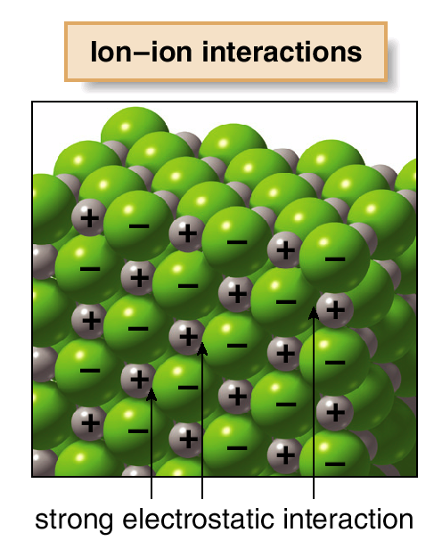
Intermolecular Forces
Intermolecular forces are interactions that exist between molecules. Functional groups determine the type and strength of these interactions.
There are several types of intermolecular interactions.
Ionic compounds contain oppositely charged particles held together by extremely strong electrostatic inter-actions. These ionic inter-actions are much stronger than the intermolecular forces present between covalent molecules.
Covalent compounds are composed of discrete molecules.
The nature of the forces between molecules depends on the functional group present. There are three different types of interactions, shown below in order of increasing strength:
van der Waals forces
dipole-dipole interactions
hydrogen bonding

Slide 4
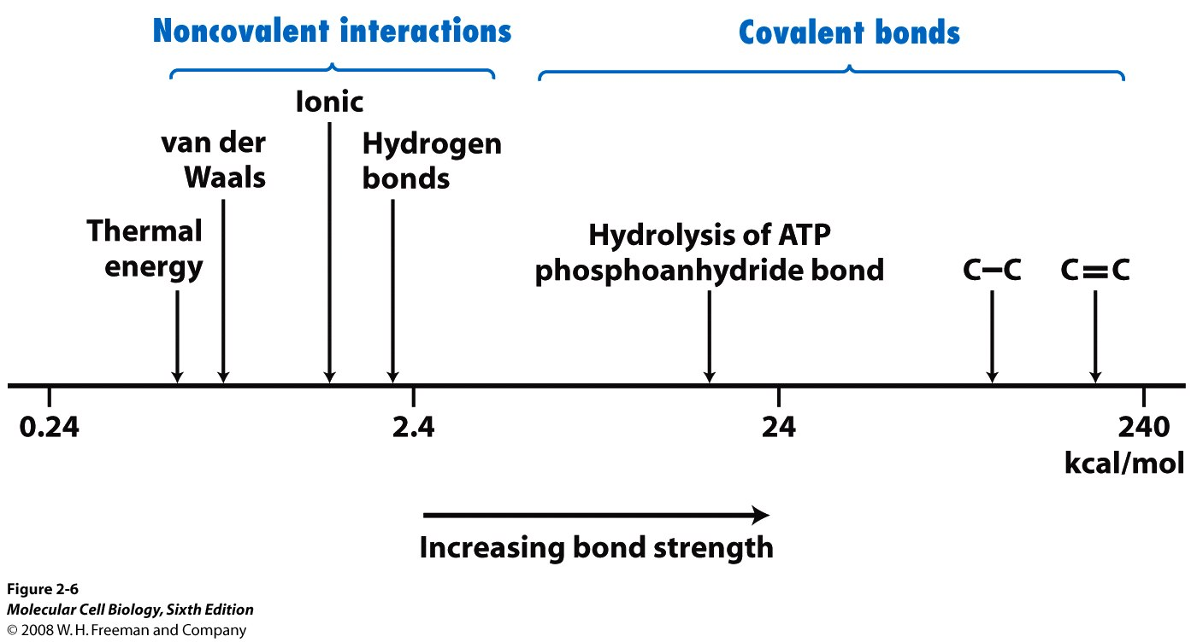
Bond Strength
Strongest
IONIC
COVALENT
Hydrogen
Dipole-Dipole
Induced Dipole
intramolecular
intermolecular
Weakest
Noncovalent interactions are weak electrical bonds between molecules. Noncovalent interactions (1-5 kcal/mol) are typically ~100-fold weaker than covalent bonds

Slide 5
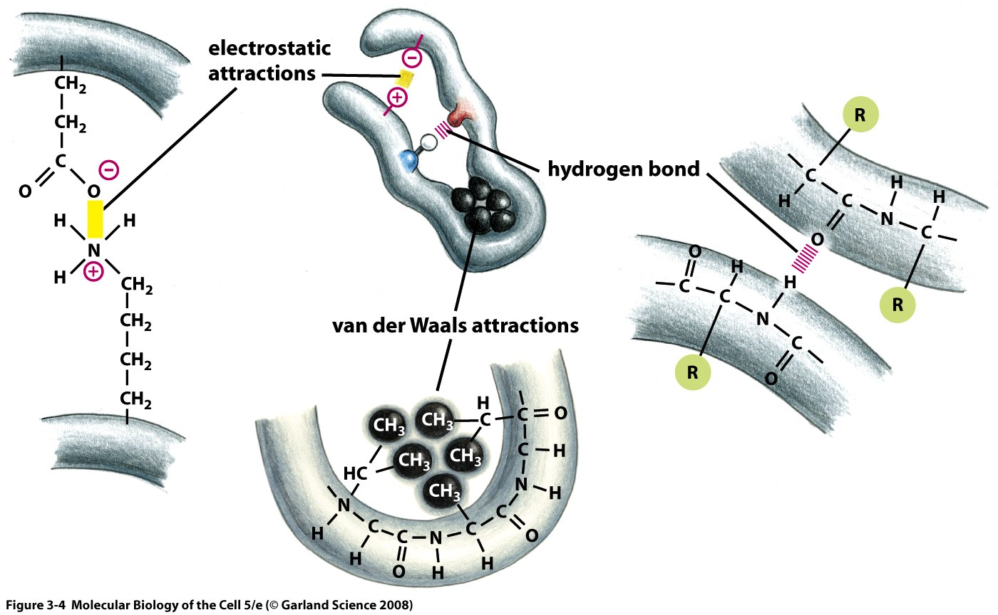
Noncovalent interactions determine protein structure
Amino acids are connected by covalent bonds called peptide bonds.
Four types of noncovalent interactions between amino acids affect protein structure:
van der Waals interactions
Electrostatic interactions (salt bridges)
Hydrogen bonds
Hydrophobic forces

Slide 6
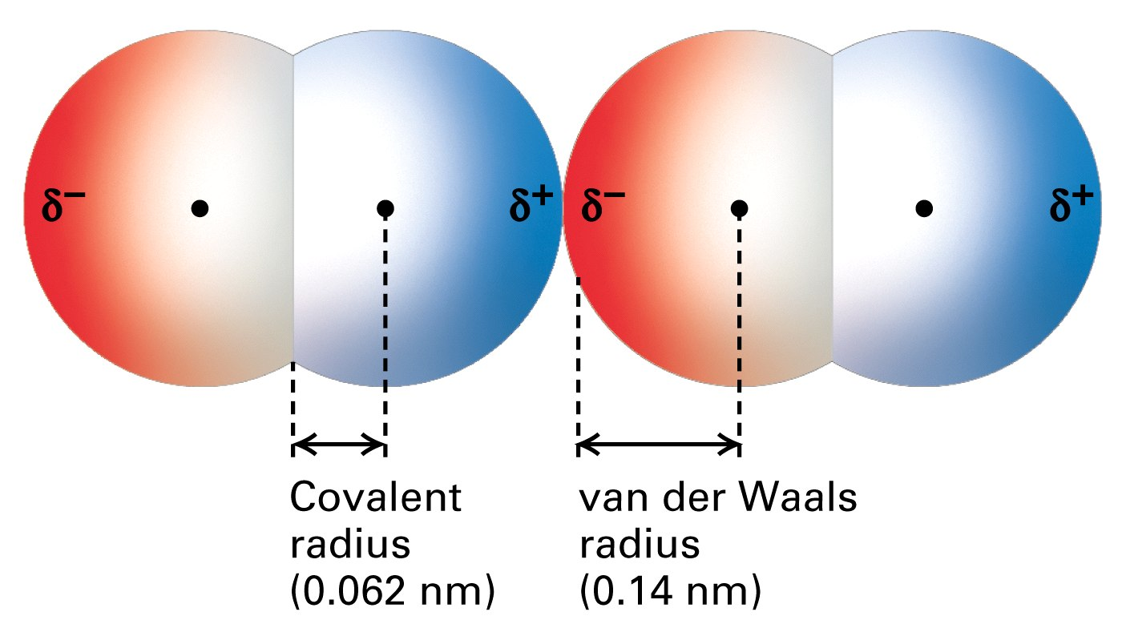
Short range repulsion
Force two atoms together and they will push back. When two atoms are close together, the occupied orbitals on the atom surfaces overlap, causing electrostatic repulsion between surface electrons. This repulsive force between atoms acts over a very short range, but is very large when distances are short.
van der Waals interactions are bonds between fluctuating, induced dipoles within the electron clouds of interacting molecules. These bonds can occur between nonpolar or polar molecules. van der Waals bonds are extremely dependent on the distance of separation between molecules, and are significant only when the electron clouds of the molecules are just touching. van der Waals interactions are demonstrated for two O₂ molecules and the covalent and van der Waals radii are shown.

Slide 7
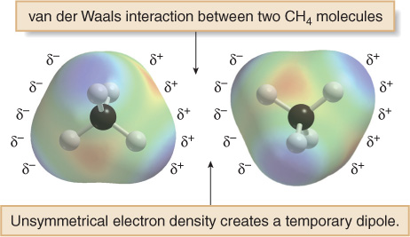
Van der Waals Forces
Van der Waals forces are also known as London forces.
They are weak interactions caused by momentary changes in electron density in a molecule.
They are the only attractive forces present in nonpolar compounds.
All compounds exhibit van der Waals forces.
The surface area of a molecule determines the strength of the van der Waals interactions between molecules. The larger the surface area, the larger the attractive force between two molecules, and the stronger the intermolecular forces.
Even though CH₄ has no net dipole, at any one instant its electron density may not be completely symmetrical, resulting in a temporary dipole. This can induce a temporary dipole in another molecule. The weak interaction of these temporary dipoles constitutes van der Waals forces.
7

Slide 8
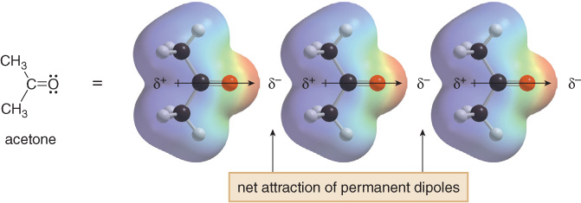
Dipole-Dipole Interactions
Dipole—dipole interactions are the attractive forces between the permanent dipoles of two polar molecules.
Consider acetone. The dipoles in adjacent molecules align so that the partial positive and partial negative charges are in close proximity. These attractive forces caused by permanent dipoles are much stronger than weak van der Waals forces.

Slide 9
Electrostatic Interactions
Intermolecular forces are interactions that exist between molecules. Functional groups determine the type and strength of these interactions.
There are several types of intermolecular interactions.
Ionic interactions occur between cations and anions.
These bonds are non-directional
These ionic inter-actions are much stronger than the intermolecular forces present between covalent molecules.
Strength depends on the distance of separation (r) according to 1/r². Strength also depends on the medium (dielectric constant), and is less in polar than nonpolar solvents.
Ionic compounds such as NaCl are readily dissolved n water. Solvation spheres of water molecules surround ions in solutions. Water molecules orient so that the negative ends of their dipoles contact cations and the positive ends contact anions in solution.
9

Slide 10
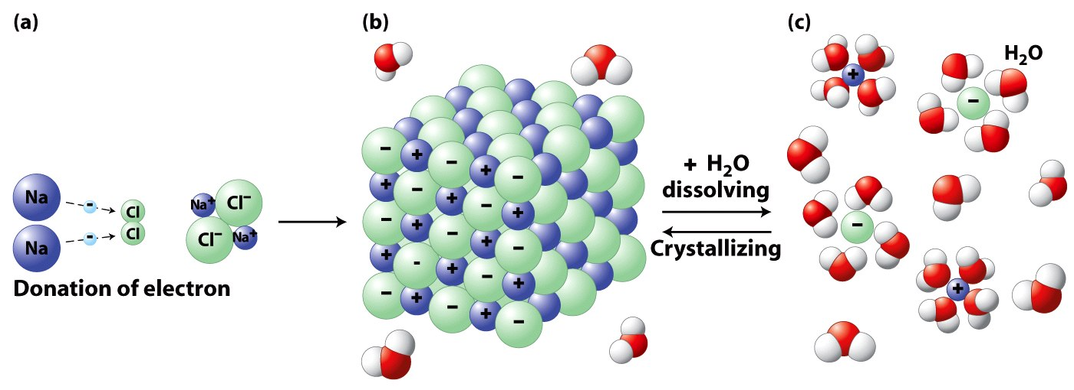
Electrostatic Interactions
Ionic compounds such as NaCl are readily dissolved n water. Solvation spheres of water molecules surround ions in solutions. Water molecules orient so that the negative ends of their dipoles contact cations and the positive ends contact anions in solution.
Favorable electrostatic interactions cause the vapor pressure of sodium chloride and other salts to be very low. If you leave crystals of table salt (NaCl; Na⁺=cation, Cl⁻=anion) on a hot pan, how long does it take before they vaporize and sublime away? A very very long time; electrostatic interactions are very very strong. The electrostatic interactions within a sodium chloride crystal are called ionic bonds. But when a single cation and a single anion are close together, within a protein, or within a folded RNA, those interactions are considered to be non-covalent electrostatic interactions

Slide 11
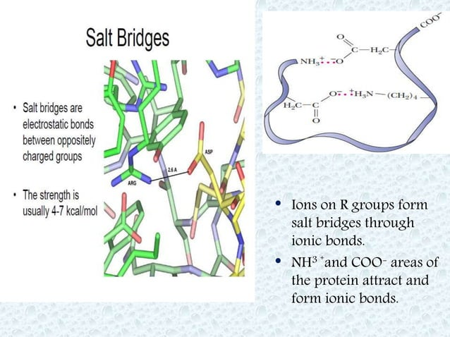
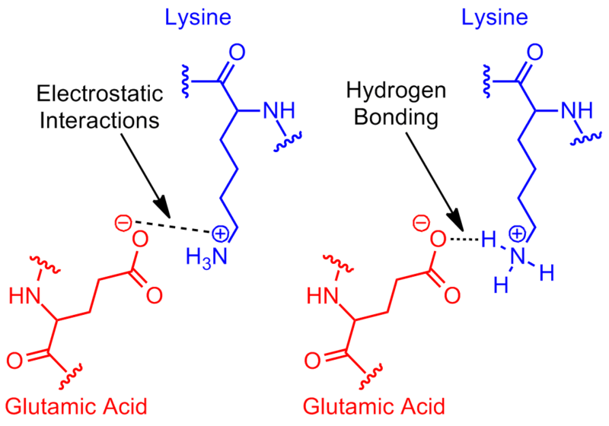
Electrostatic Interactions (Salt Bridge)
A salt bridge is a non-covalent interaction between two ionized sites. It has two components: a hydrogen bond and an electrostatic interaction. Salt bridges in proteins are bonds between oppositely charged residues that are sufficiently close to each other to experience electrostatic attraction.

Slide 12
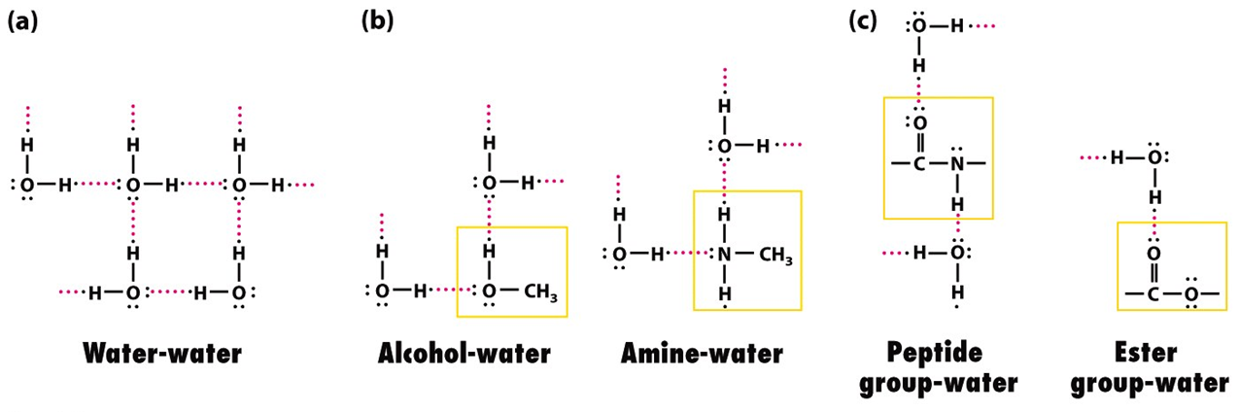
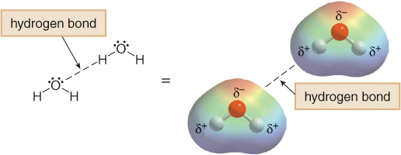
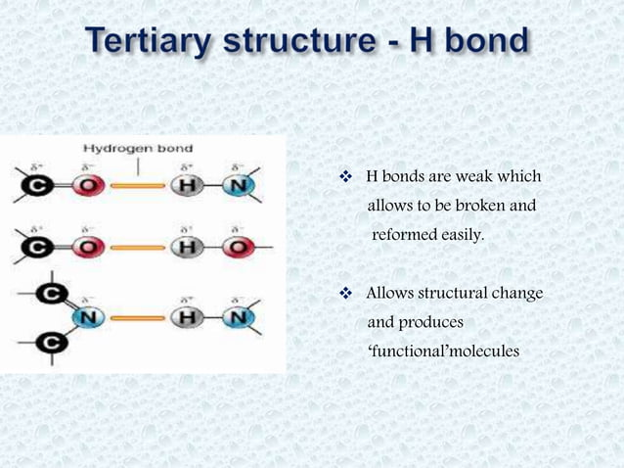
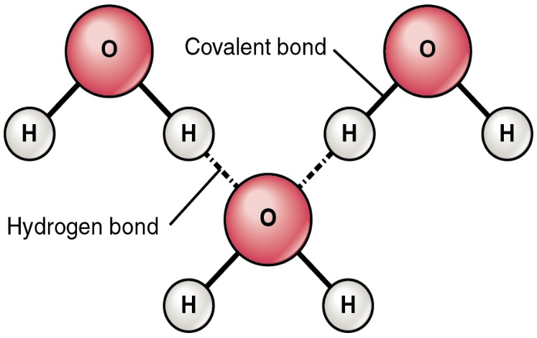
Hydrogen Bonding
Hydrogen bonding typically occurs when a hydrogen atom bonded to O, N, or F, is electrostatically attracted to a lone pair of electrons on an O, N, or F atom in another molecule.
12
δ⁻
δ⁻
δ⁺
δ⁺
δ⁺
δ⁺
δ⁻
δ⁺
δ⁺
Hydrogen “bond”

Slide 13
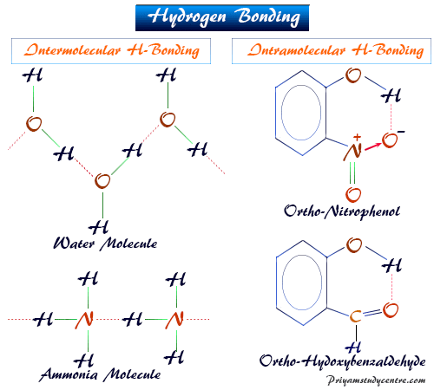
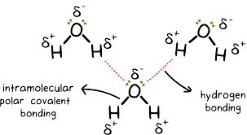
Why does Hydrogen “bonding” occur?
O
Water is a POLAR molecule, there are unshared pairs of electrons on the central atom.
H
H
More on intermolecular forces Hydrogen “Bonding”
STRONG intermolecular force Like magnets
Occurs ONLY between H of one molecule and N, O, F of another molecule

Slide 14
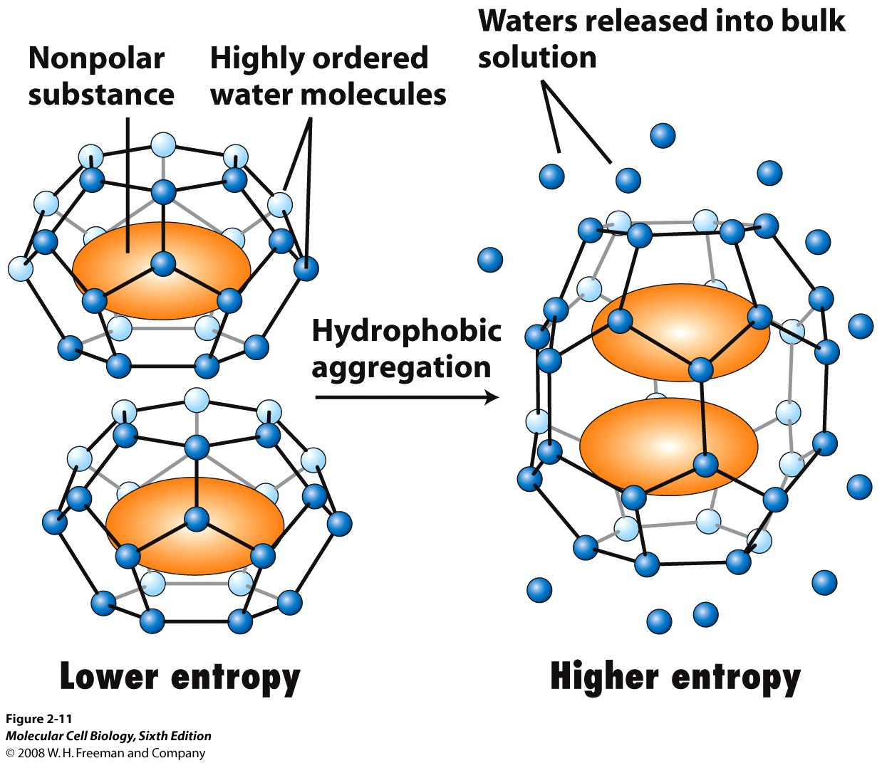
The Hydrophobic Effect
The hydrophobic effect refers to the entropy-driven aggregation of nonpolar molecules in aqueous solution that occurs to minimize the ordering of water molecules with which they are in contact. This is not an attractive force, but rather a thermodynamically driven process.
The cage-like structures formed by water molecules surrounding a nonpolar solute. The hydrophobic effect drives the formation of membranes and contributes to the folding of proteins and the formation of double helical DNA.

Slide 15
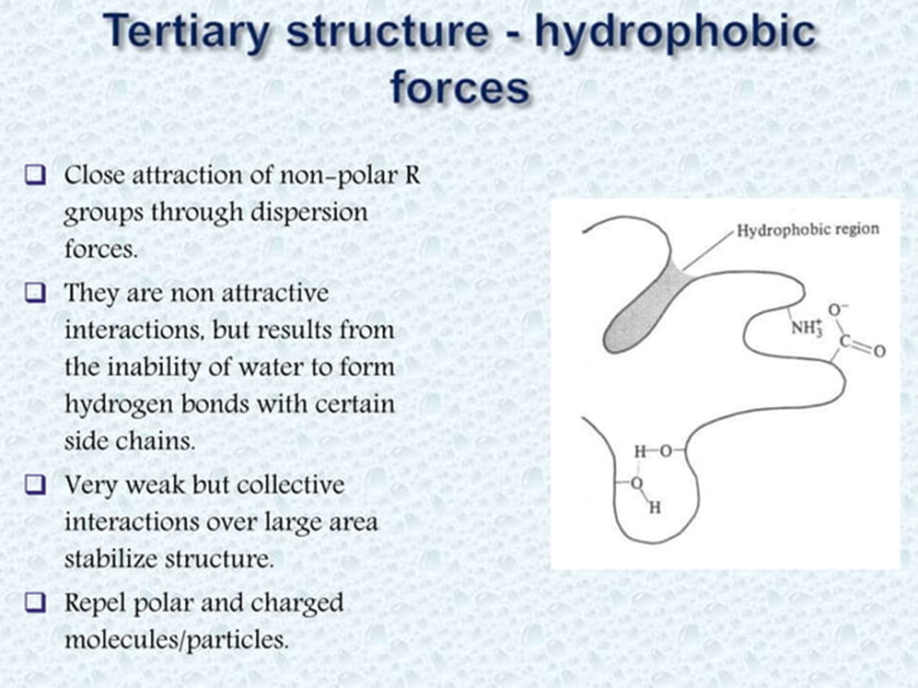

Slide 16
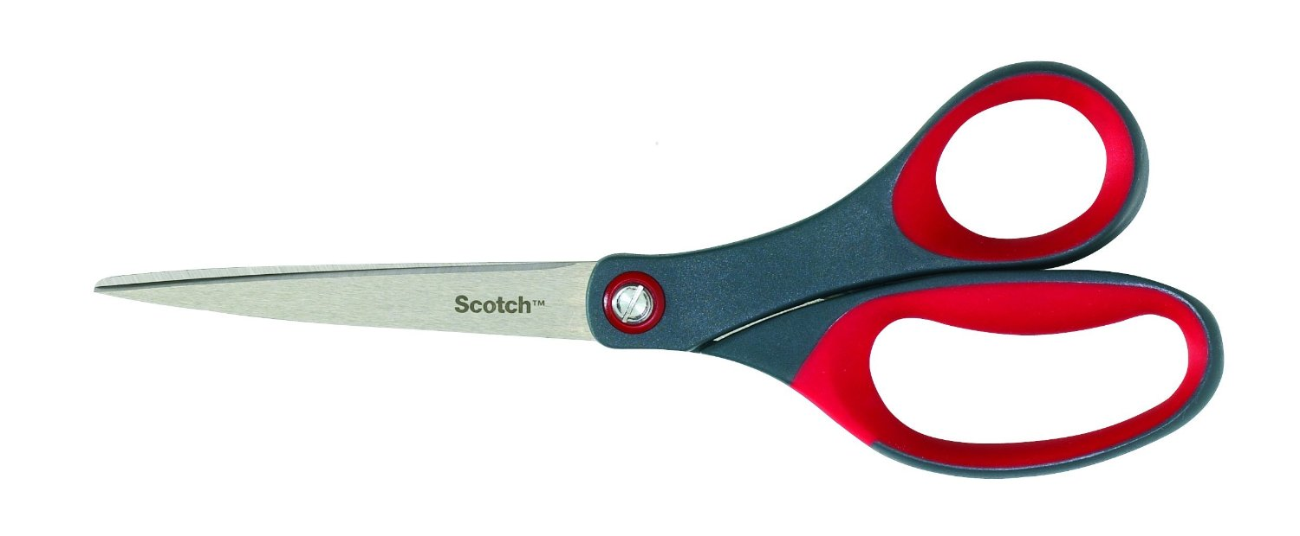

Structure affects function

Slide 17
Molecular Topology

Slide 18
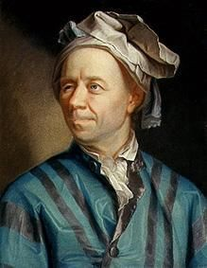
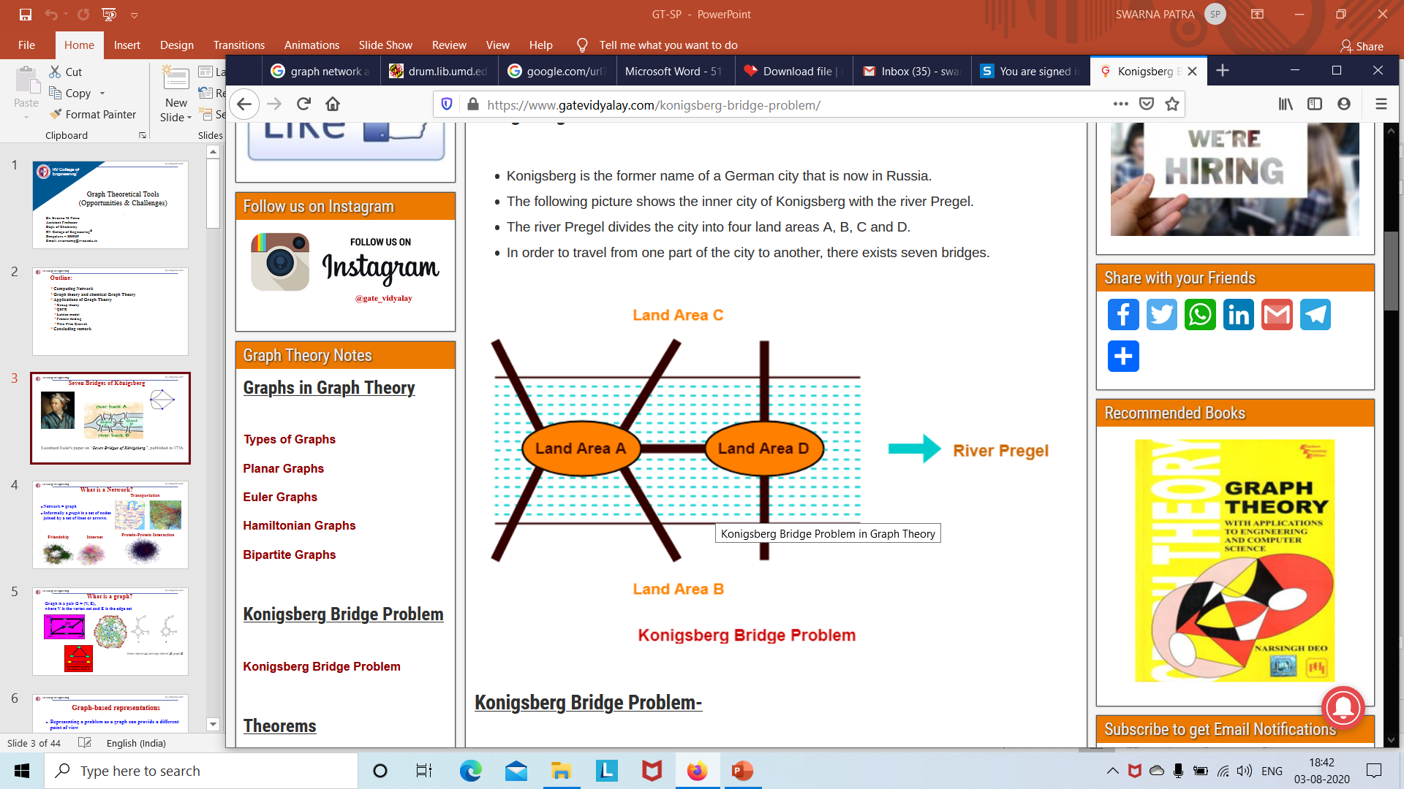
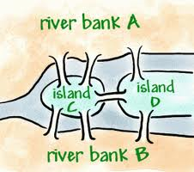
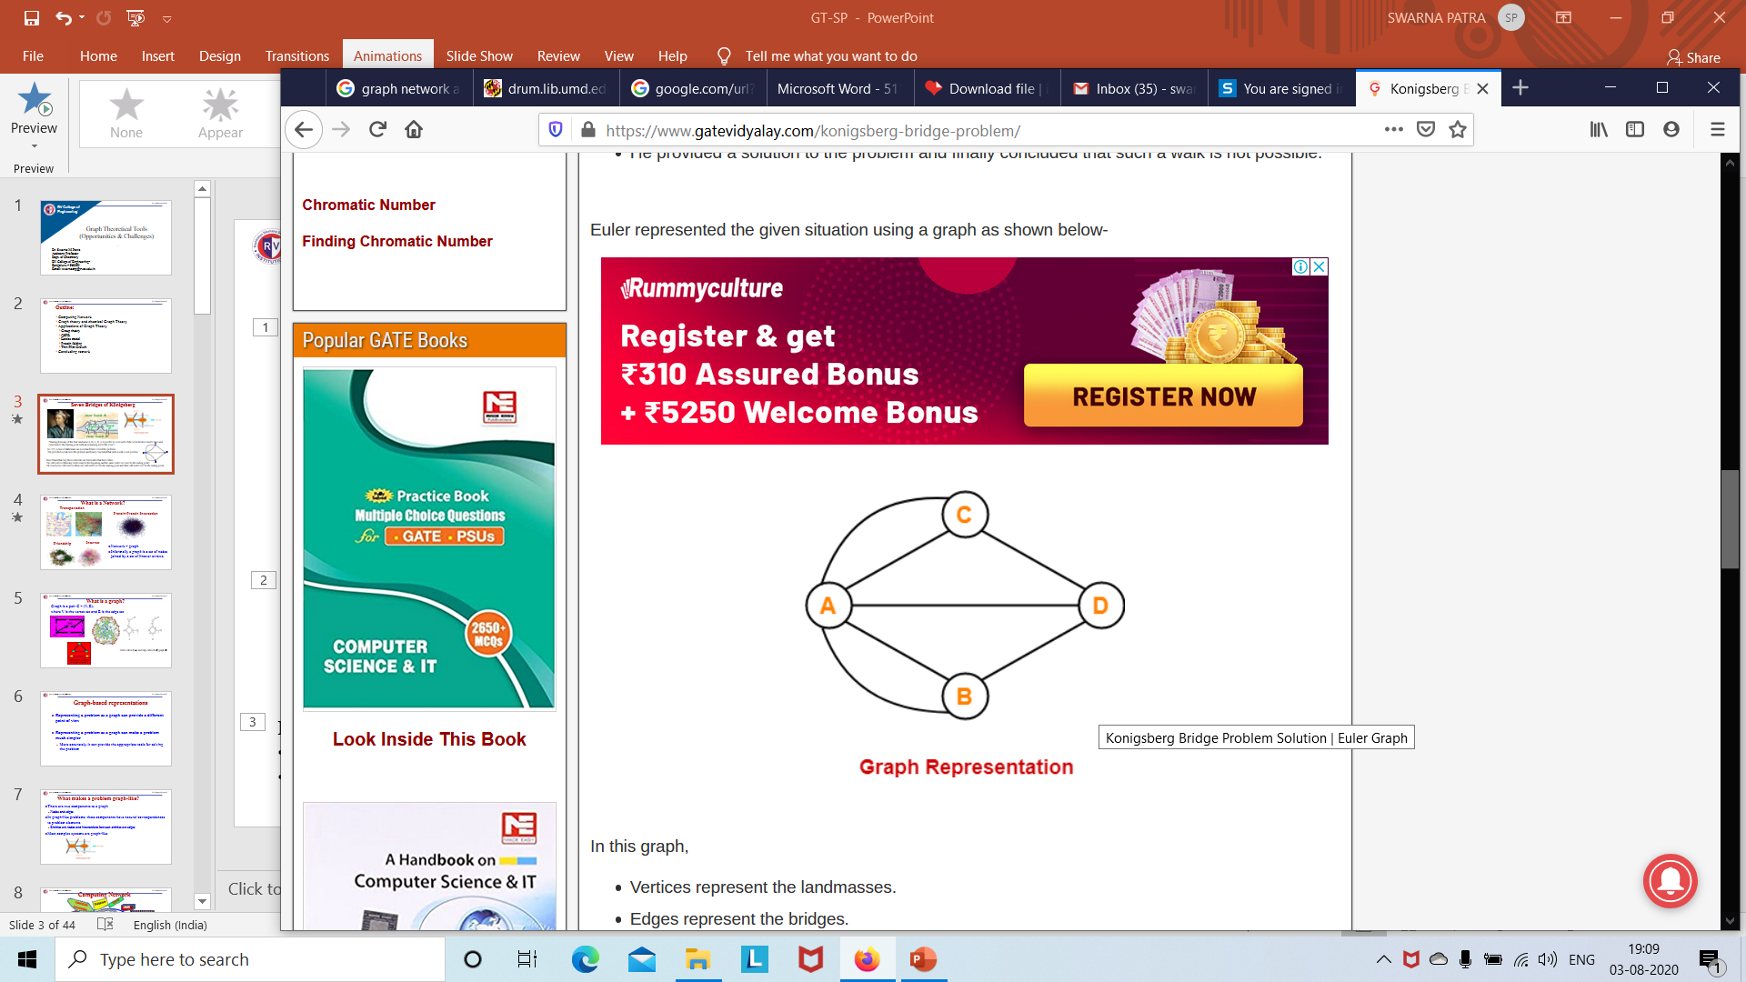
Seven Bridges of Königsberg
“Starting from any of the four land areas A, B, C, D, is it possible to cross each of the seven bridges exactly once and come back to the starting point without swimming across the river?”
In 1735, A Swiss Mathematician Leon hard Euler solved this problem.
He provided a solution to the problem and finally concluded that such a walk is not possible.
Euler found that only those networks are traversable that have either-
No odd vertices (then any vertex may be the beginning and the same vertex will also be the ending point)
Or exactly two odd vertices (then one odd vertex will be the starting point and other odd vertex will be the ending point)
Notes:
Konigsberg City was in Germany and was built around river Pregal. Two large islands in the middle of river they were connected to each other and to the river bank. The citizens of Königsberg spent their Sundays walking around town, enjoying their beautiful city. In the process, they came up with a game — which, as it turned out, proved to be incredibly difficult to accomplish. The goal was to walk across all of the seven bridges crossing the islands only once, without ever repeating a single bridge in the course of one’s walk.

Slide 19
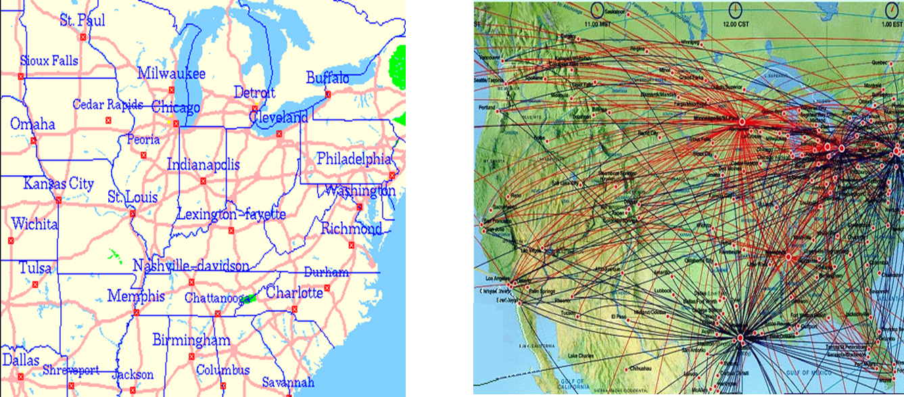
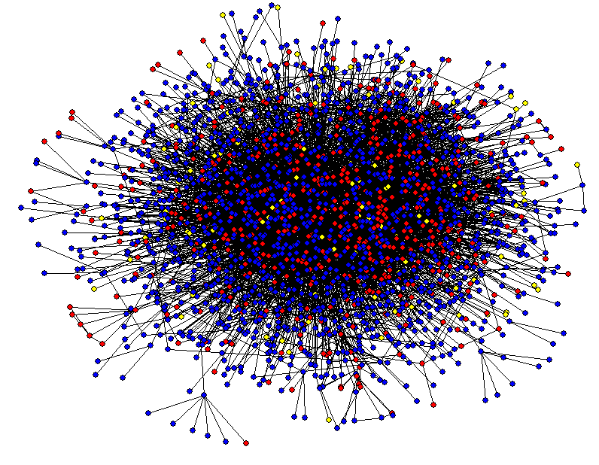
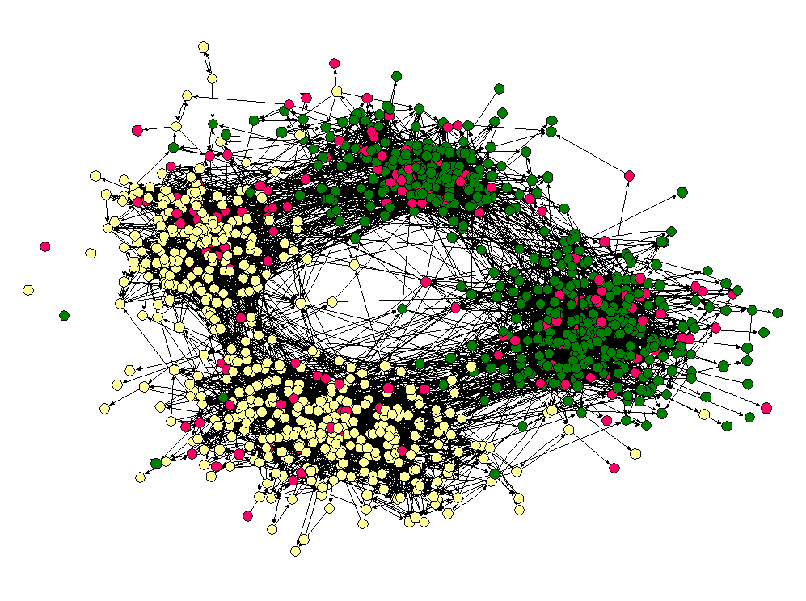
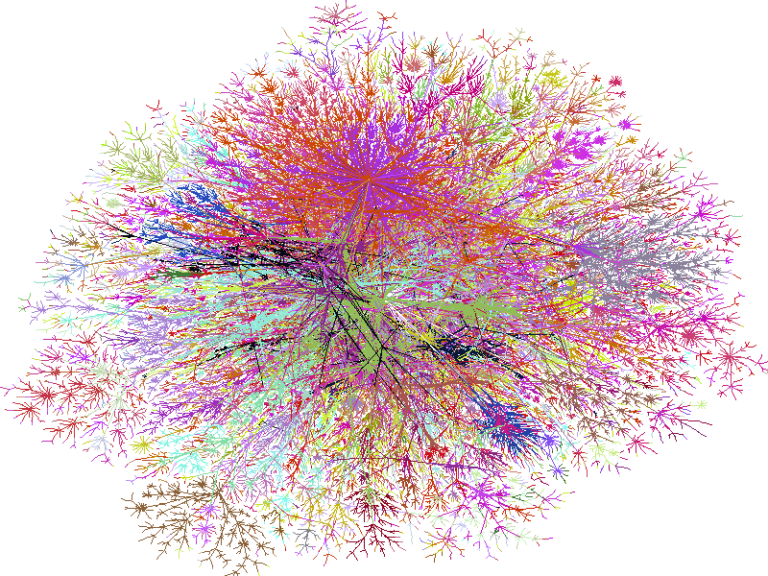
What is a Network?
Transportation
Protein-Protein Interaction
Friendship
Internet
Network = Graph
Informally a graph is a set of nodes joined by a set of lines or arrows.

Slide 20
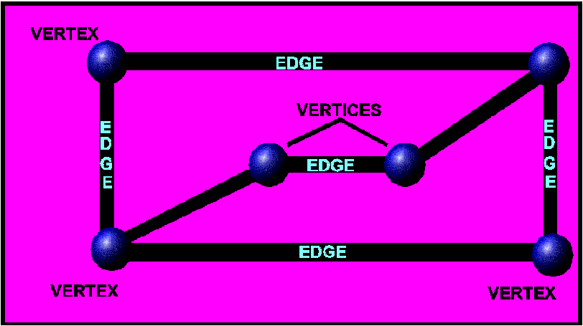
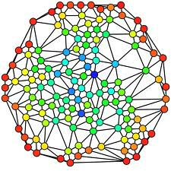
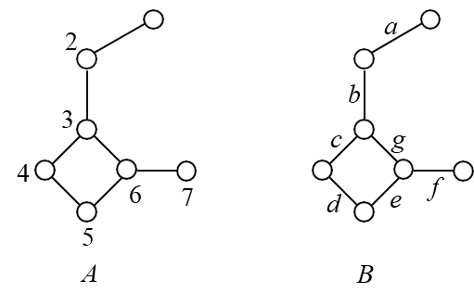
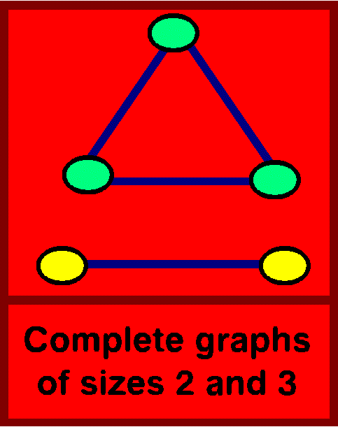
What is a graph?
Graph is a pair G = (V, E),
where V is the Vertex set and E is the Edge set
Vertex-labeled (A) and edge-labeled (B) graph G

Slide 21
Graph-Based Representations
Representing a problem as a graph can provide a different point of view
Representing a problem as a graph can make a problem much simpler
More accurately, it can provide the appropriate tools for solving the problem

Slide 22
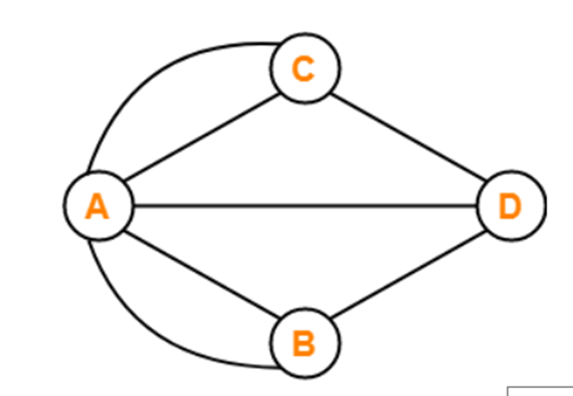
What makes a problem graph-like?
There are two components to a graph
Nodes and Edges
In graph-like problems, these components have natural correspondences to problem elements
Entities are nodes and interactions between entities are edges
Most complex systems are graph-like

Slide 23
Computing Network
Polymer
QSPR
Quantum Chemistry
LIMS
Reaction Mechanism
Molecular Dynamics
Lattice Model
Scientific Database
Protein Folding
Kekule Structure Count
DFSS
Graph Theory
Ion Permeation
Docking
Group Theory
Ligand Binding
Thin Film
Binding Energy

Slide 24
Connectivity
Group Theory
Quantum Chemistry
Thin Film
Graph Theory
Lattice Model
Kekule Structure Count
QSPR
Polymer
Protein Folding

Slide 25
Basic Notations
adjacency – u, v adjacent if {u, v} edge
vertex degrees – number of adjacent vertices
paths – sequences u_{1,} u₂...u_{n} such that each {u_{i}, u_{i+1}} is an edge + no multiple edges
circuits – closed paths
cycles – circuits with all vertices appearing only once
simple graphs – no loops and no multiple edges
connected graphs – every two vertices connected by a path
trees – connected graph without cycles

Slide 26
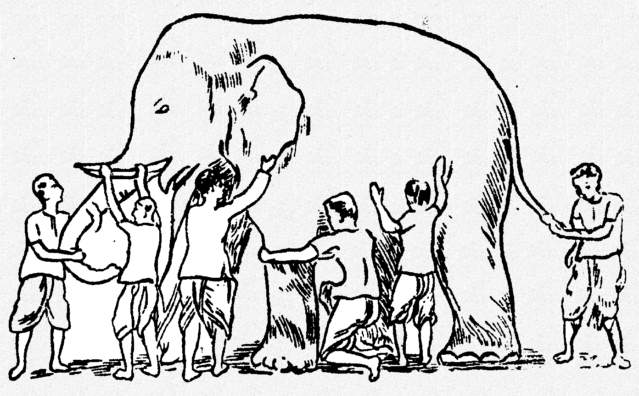
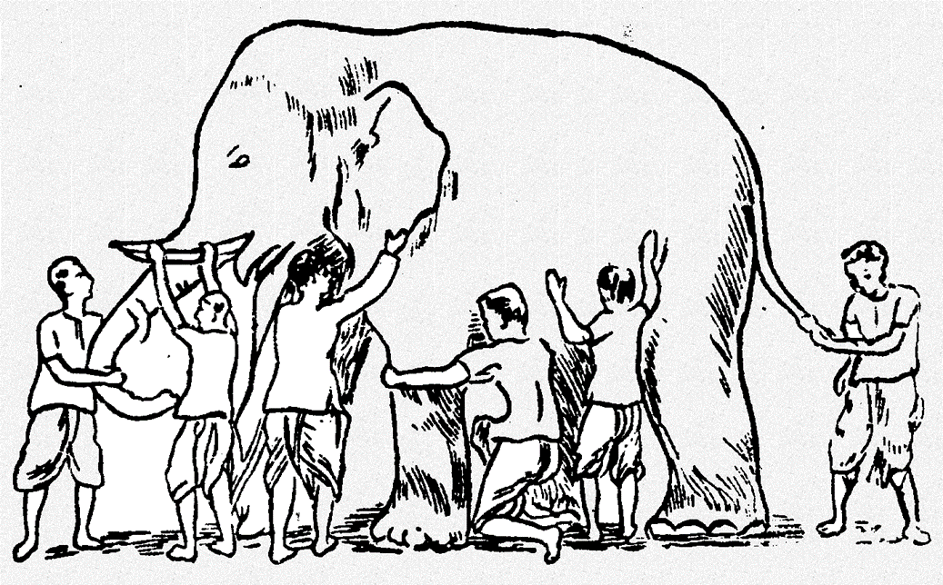
Similarity & Molecular Similarity ?
“Similarity" can have quite different meanings in chemical approaches.
Molecular Similarity does not just mean similarity of structural features.
Similarity in a chemical context must include additional properties.

Slide 27
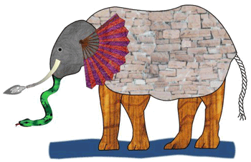
It’s an Elephant
The Fourth reached out an eager hand,
And felt about the knee.
“What most this wondrous beast is like
Is mighty plain,” quoth he;
“ ‘Tis clear enough the Elephant
Is very like a tree!”
The Fifth, who chanced to touch the ear,
Said: “E’en the blindest man
Can tell what this resembles most;
Deny the fact who can
This marvel of an Elephant
Is very like a fan!”
The Sixth no sooner had begun
About the beast to grope,
Than, seizing on the swinging tail
That fell within his scope,
“I see,” quoth he, “the Elephant
Is very like a rope!”
And so these men of Indostan
Disputed loud and long,
Each in his own opinion
Exceeding stiff and strong,
Though each was partly in the right,
And all were in the wrong!
- John Godfrey Saxe (1816-1887)
It was six men of Indostan
To learning much inclined,
Who went to see the Elephant
(Though all of them were blind),
That each by observation
Might satisfy his mind
The First approached the Elephant,
And happening to fall
Against his broad and sturdy side,
At once began to bawl:
“God bless me! but the Elephant
Is very like a wall!”
The Second, feeling of the tusk,
Cried, “Ho! what have we here
So very round and smooth and sharp?
To me ’tis mighty clear
This wonder of an Elephant
Is very like a spear!”
The Third approached the animal,
And happening to take
The squirming trunk within his hands,
Thus boldly up and spake:
“I see,” quoth he, “the Elephant
Is very like a snake!”

Slide 28
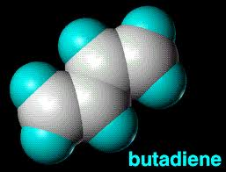
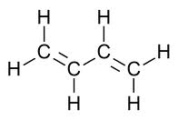
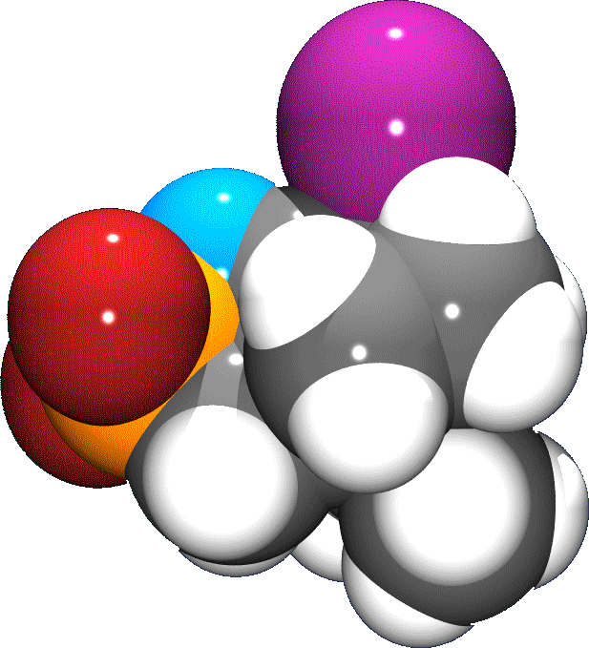
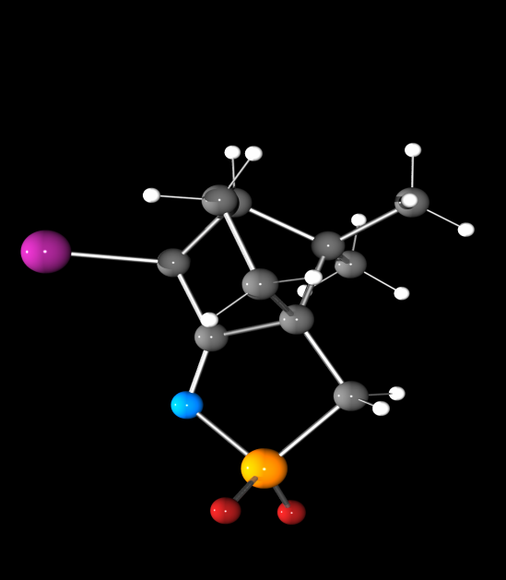
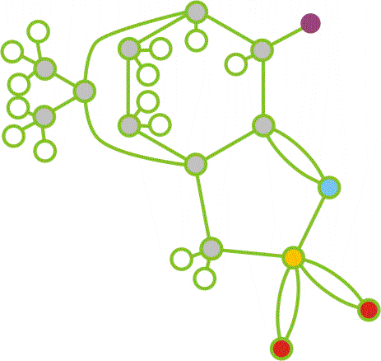
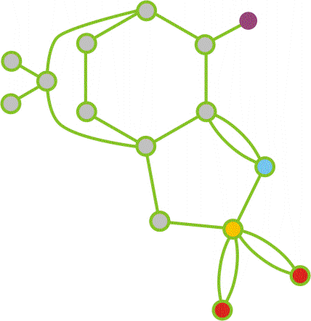
Graphs in chemistry
molecular (structural) graphs (often: hydrogen-supressed)
degree of a vertex = valence of atom

Slide 29
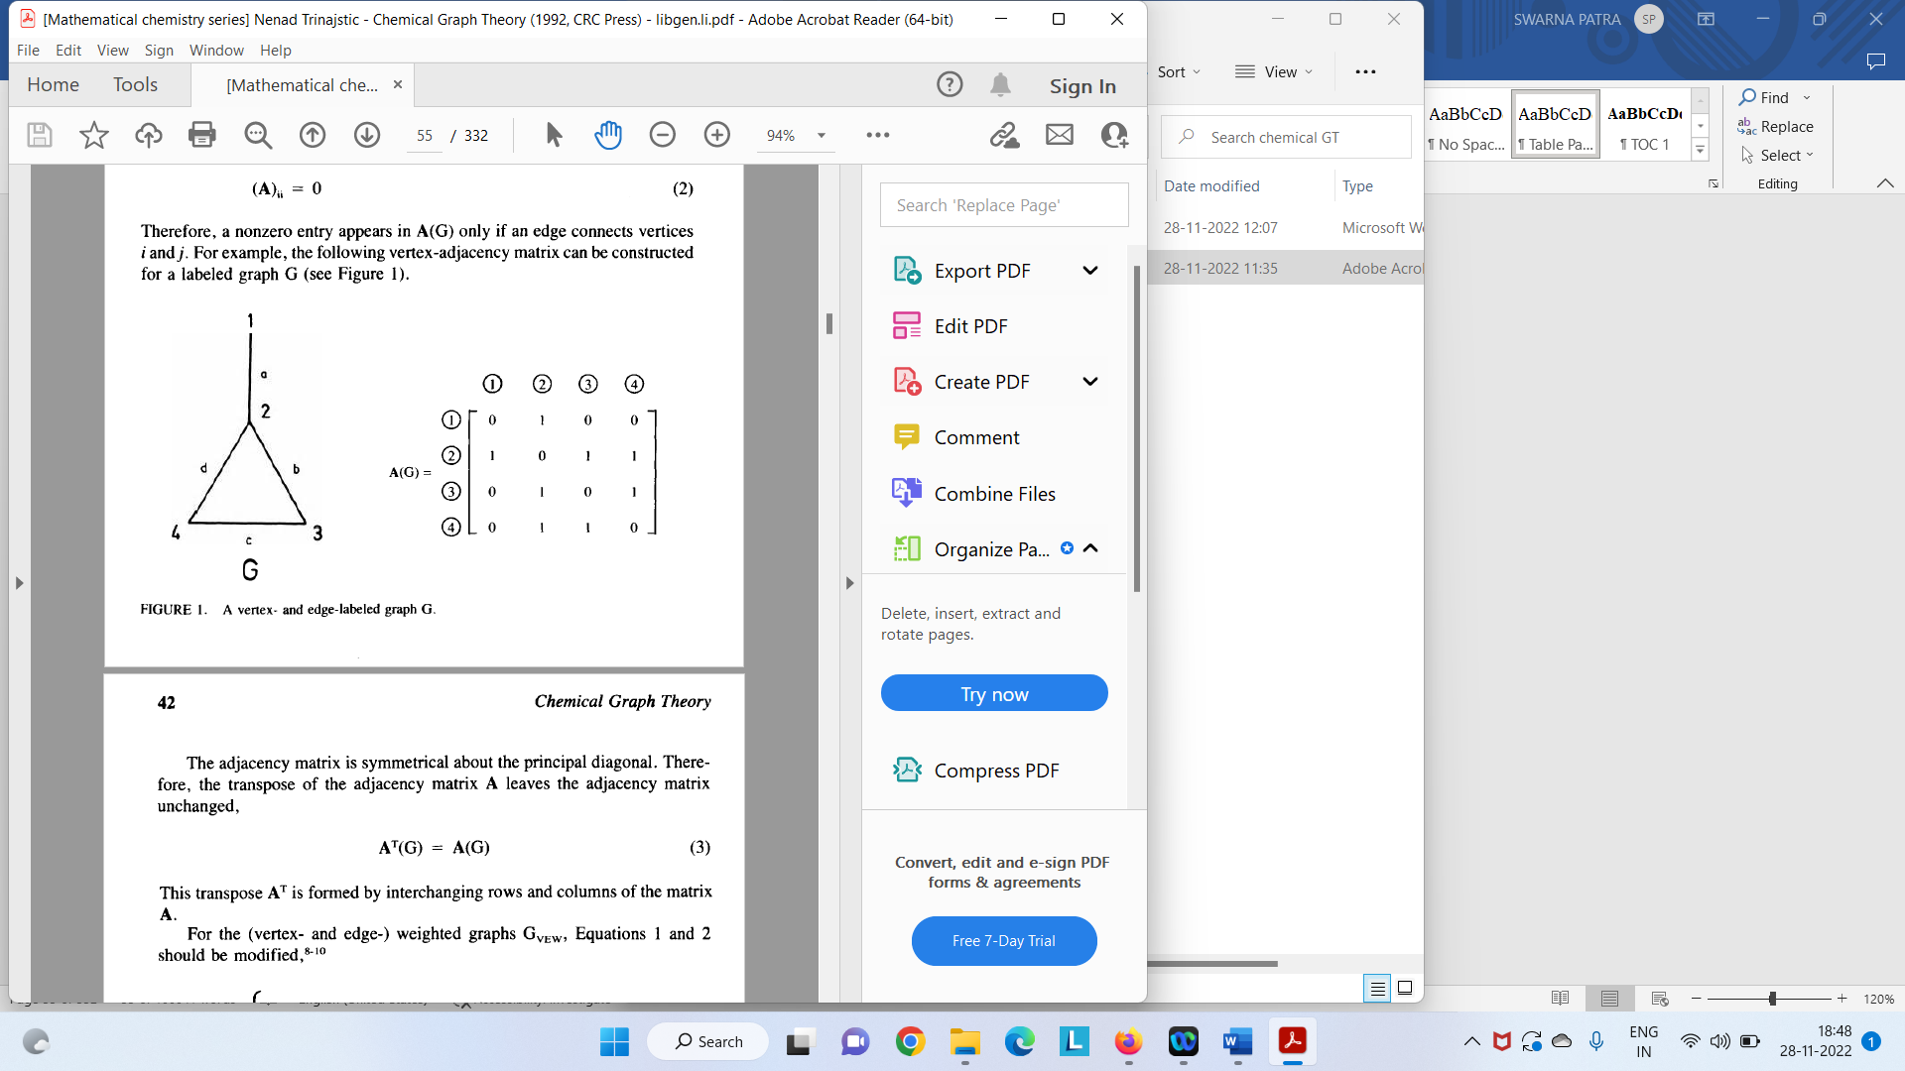
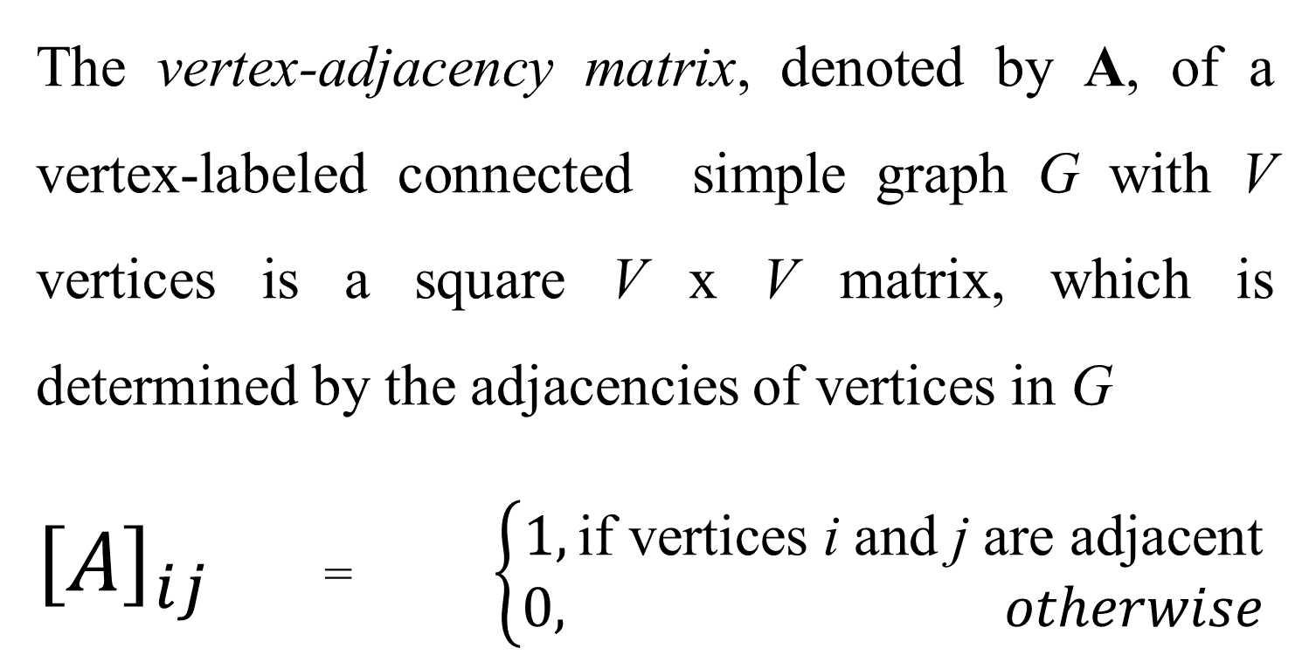
Vertex Adjacency Matrix
The vertex-adjacency matrix, denoted by A, of a vertex-labeled connected simple graph G with V vertices is a square V x V matrix, which is determined by the adjacencies of vertices in G
${\left[A\right]}_{ij }$= $\left\{\begin{aligned}1,\text{if} \text{vertices} \text{i} \text{and} \text{j} \text{are} \text{adjacent} \\ 0, otherwise\end{aligned}\right.$

Slide 30
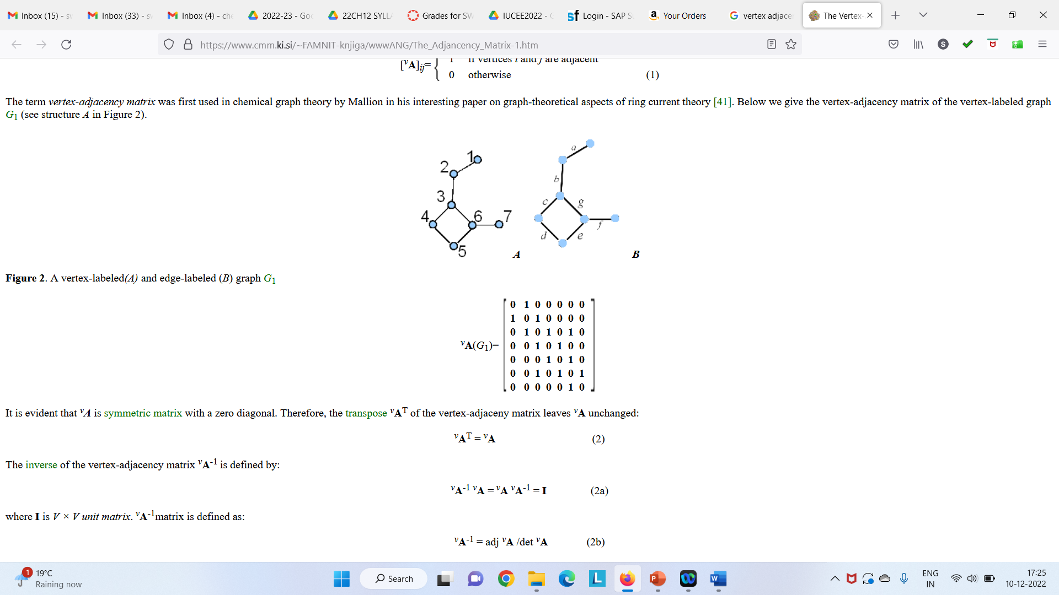
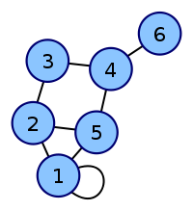
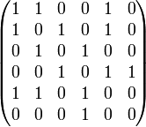
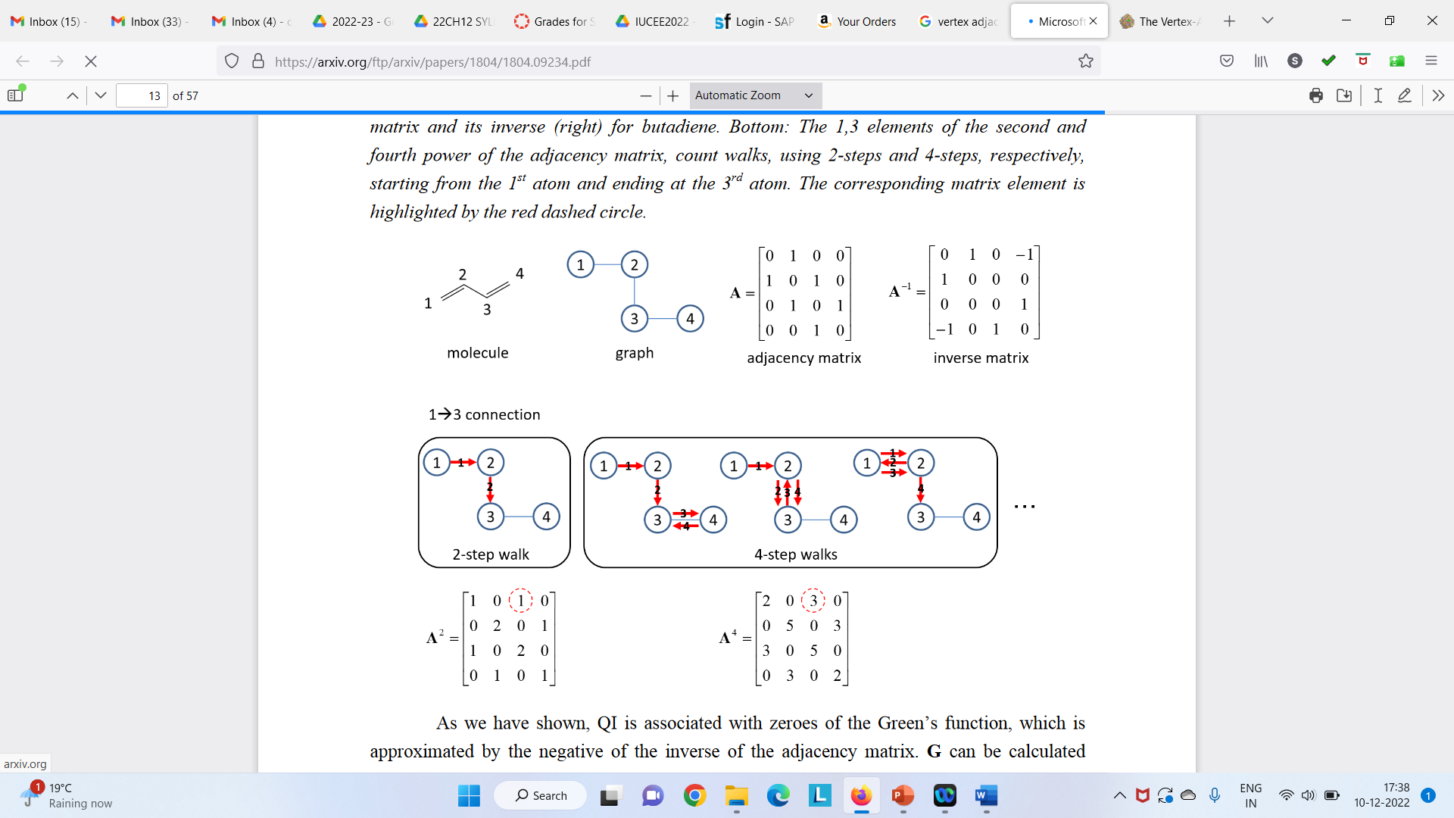
Vertex Adjacency Matrix

Slide 31
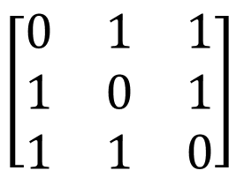
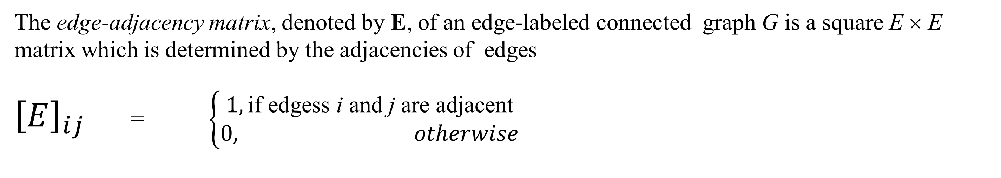
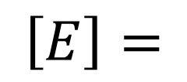
Edge Adjacency Matrix
b
$$\left[\begin{matrix}0 & 1 & 1 \\ 1 & 0 & 1 \\ 1 & 1 & 0\end{matrix}\right]$$
a
b
$$\left[E\right]=$$
a
c
c
S₃
C₃
The edge-adjacency matrix, denoted by E, of an edge-labeled connected graph G is a square E × E matrix which is determined by the adjacencies of edges
${\left[E\right]}_{ij }$= $\left\{\begin{aligned}1,\text{if} \text{edges}\text{s} \text{i} \text{and} \text{j} \text{are} \text{adjacent} \\ 0, otherwise\end{aligned}\right.$
It should be noted that the vertex-adjacency matrix uniquely determines a graph, but the edge-adjacency matrix does not, that is, there are known graphs with identical edge-adjacency matrices. A pair of nonisomorphic graphs – the three-point star S₃ and the cycle on three vertices C₃ – possessing identical edge-adjacency matrices.

Slide 32
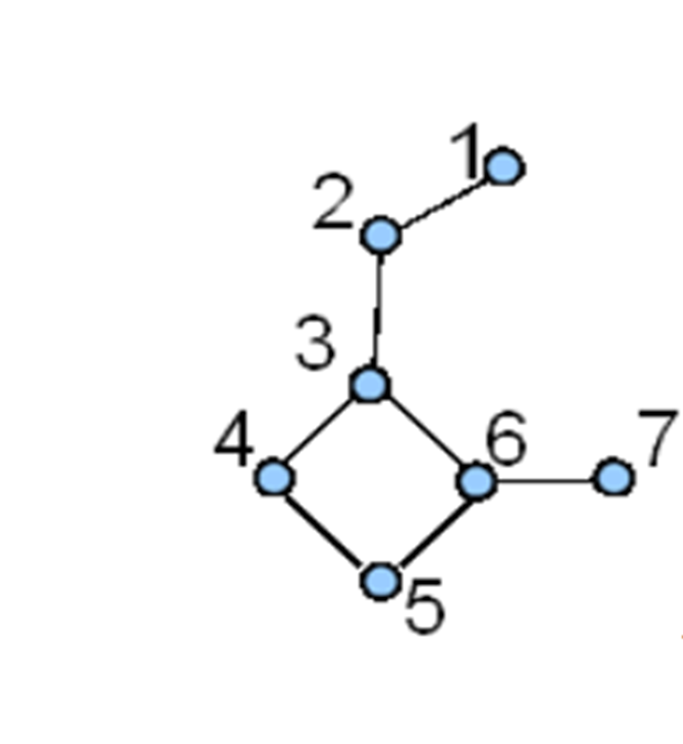


Edge Adjacency Matrix

Slide 33

Distance Matrix

Slide 34



Vertex-Adjacency Matrix of Weighted Graphs
1
3
k
5
The parameters h and k depend, respectively, on the chemical nature of the corresponding atoms and bonds in a molecule. Some people select for them the values of the Hückel parameters for heteroatoms and heterobonds.
h k
k h
10
k
8
6
9
7
$$\left[A\right]$$
$\left[A\right]$ =

Slide 35
Hückel Matrix
The Hückel matrix in the Hückel theory of conjugated systems considered as the augmented vertex-adjacency matrix.
In the Hückel theory, the secular equation solved for a given conjugated system is given by
det |-e_{i} S + H| = 0; i=1,…,V
Where H is the Hamiltonian matrix, S is the overlap matrix, e_{i} is the set of eigenvalues and V is the number of π-electrons in a conjugated molecule. The Hamiltonian matrix and the overlap matrix in the Hückel theory are simplified by using the set of approximations known in the quantum-chemical literature as the Hückel approximations
where I is the unit V × V matrix,
α is an atomic parameter (atomic Coulomb integral) and
β is a bond parameter (resonance integral).
H = α I + β A, S = I
The eigenvalue equation for a matrix A can be expressed as A – λI = 0
The solution to this equation are the eigenvalues λ_{i} = a _{i,i} (i = 1, 2, -----n)

Slide 36



Characteristic Polynomial

Slide 37



Delocalization Energy of Butadiene
The delocalization energy is the extra stabilization that comes from letting the electrons spread over the whole molecule.
X² - 1
( ± 1)
E_{Π} = 2(α + β)
= X⁴ - 3X² + 1
( ± 1.618, ± 0.618)
E_{Π} = 2(α + 1.618β) + 2(α + 0.618β) = 4α + 4.472β
delocalization energy = (4α + 4.472β) - 2(2α +2β) = 0.472β

Slide 38
Topological Descriptors
A topological index, sometimes also known as a graph-theoretic index, is a numerical invariant of a chemical graph, some examples of topological indices include the Balaban index, Harary index, molecular topological index, and Wiener index.
Unless otherwise stated, hydrogen atoms are usually ignored in the computation of such indices
The topological index of a graph is defined by TI = | A + D |
where A is the adjacency matrix, D is the graph distance matrix, and | A + D |denotes the determinant of the matrix addition

Slide 39


Topological Descriptors
Zagreb Index Z one counts the connections from each vertex (node, carbon).
The first Zagreb index M 1(G) is equal to the sum of squares of the degrees of the vertices
The second Zagreb index M 2(G) is equal to the sum of the products of the degrees of pairs of adjacent vertices of the underlying molecular graph
Method of calculation: If δ_{i} is the degree of vertex i then
M₁ = 1² + 2² + 2² + 2² + 1² = 1 + 4 + 4 + 4 + 1= 14
M₂= 1x2 + 2x2 + 2x2 + 2x1 = 2+4+4+2 = 12
Zagreb group indices were introduced to characterize branching

Slide 40
Topological Descriptors
Wiener Number W is the total distance between all carbon atoms (sum of the distances between each pair of carbon atoms in the molecule, in terms of carbon-carbon bonds).
The smaller this number, the larger is the compactness of the molecule.
Method of calculation: Multiply the number of carbon atoms on one side of any bond by those on the other side; W is the sum of these two values for all bonds.
W can also be obtained by simply adding all the elements of the graph distance matrix above the main diagonal.
Or This topological index is defined as the half-sum of the elements of the distance matrix.
6
W = 6+ 6+12+6+10+6
6
6
12
10
6
Weiner showed that the index value is closely correlated with the boiling point of a series of alkanes, also observed that it is correlated with other physical properties such as density, surface tension and viscosity.

Slide 41


Topological Descriptors
Platt Number F Is equal to the total sum of edge-degrees in a graph G. The edge-degree of an edge e, D(e), is the number of its adjacent edges. This index was named the Platt number.
Method of calculation: The Platt number of a graph G is defined by
F(G) =$\sum_{i=1}^{M}{D(e_{i})}$, The Platt number, thus represents the first neighbors sum.
F = 2 + 2 + 3 + 3 + 2 + 2 = 14
2, 4 di-methyl pentane
Predicting physical parameters (molar volumes, boiling points, heats of formation, heats of vaporization) of alkanes

Slide 42

Topological Descriptors
Largest Eigenvalues x_{i} Is equal to the highest eigenvalues of the characteristic polynomial
Method of calculation:
P(G;x) = det |xI - A| or det |A- xI|
solve the characteristic polynomial P(G;x) = 0
Alkane Tree xi
Branching

Slide 43



Predictive Model for Glass Transition Temperature
Glass transition temperature:
Tg of a non-crystalline material is the critical temperature at which the material changes its behavior from being glassy to rubbery
A predictive tool designed to predict the glass transition temperature of polyesters.
Based on monomer unit the topological indices were calculated and used in the transfer function.
In house validation and high impact on business
Patra, GE Plastic (confidential)

Slide 44


Octane Isomers
The number of terminal methyl groups are considered for the subgrouping of the molecules**
C
D
A
B
E
F
**H.Narumi and H.Hosoya, Bull. Chem. Soc. Jpn., 53, 1228 (1980)

Slide 45
Ordering of Octane Isomers and Topological Indices
The eigenvalues of eighteen octane isomers are conjugated (± λ1, ± λ2, ± λ3, ± λ4)
The number of terminal methyl groups are considered for subgrouping of the isomers
The maximum eigenvalue of graph depicts the branching character
The ordering of isomeric molecule and generation of topological descriptors done using eigenvalues
A – (- λ 1 , λ4)
B – (- λ 2 , λ4)
C – (- λ 3 , λ4)
D – (- λ 4 , λ4)
E – (- λ 5 , λ4)
F – (- λ 6 , λ4)
Two descriptor designed as (λa + λb) & (λa*λb)

Slide 46

How can we study the molecular properties ?
Graph Theory : Topology
Molecular Dynamics : A computer simulation of physical movement of atoms and molecules.
Computer simulation act as a bridge between microscopic length and time scales and the macroscopic world of the laboratory. A computer simulation of physical movement of atoms and molecules. This computational method calculates the time dependent behaviour of a molecular system.
In MD simulations, one follows the trajectories of N particles according to Newton’s equation of motion:
where U(r₁,…, r_{N}) is the potential energy function consisting of bonded and non-bonded interactions.

Slide 47
QSPR/QSAR
Hypothesis
Design
Traditional Hypothesis Driven Research Paradigm
Experiment
Data
Data analysis
Result
Structure-Activity Relationships
X
CHEMICAL/
BIOLOGICAL
ACTIVITY
MOLECULAR
STRUCTURE
Computational
Chemistry
Statistical Methods
MOLECULAR
DESCRIPTOR
REPRESENTATION

Slide 48

Datasets are represented by a matrix of molecular descriptors
Compounds represented by vectors
in a multidimensional descriptor space
Samples (Compounds) | Variables (descriptors)
 | X₁ | X₂ | ... | X_{m}
1 | ^{X}11 | ^{X}12 | ... | ^{X}1m
2 | ^{X}21 | ^{X}22 | ... | ^{X}2m
... | ... | ... | ... | ...
n | ^{X}n1 | ^{X}n2 | ... | ^{X}nm

Slide 49

QSAR Modeling
Establish quantitative relationships between descriptors and the target property capable of predicting activities of novel compounds
Chemistry Comp.1
Comp.2 Comp.3
- -
Comp.N
Bioactivity (IC50, Kd...)
Value1 D₁
Value2 "
Value3 "
- - - - - - - - - -
ValueN "
Cheminformatics
(Molecular Descriptors)
D₂ D₃ | D_{n}
" " | " "
" |
- - - - - - - - - -
"
" " | "
2.5
BA = F(D) (linear,
e.g., -LogIC50 = k₁D₁+k₂D₂+…+k_{n}D_{n}) or non-linear, e.g. k nearest neighbors
Predicted LogED50
2
1.5
1
0.5
0
0
1 2 3
Actual LogED50 (ED50 = mM/kg)
4

Slide 50

QSAR modeling with non-curated datasets

Slide 51

Data curation workflow

Slide 52
Molecular Structures
Sources of Molecular Structures
Structures of molecules can be determined experimentally or predicted computationally. For small volatile molecules, such as carbon monoxide, and water, analysis of rotational lines in the microwave or infrared spectra of gaseous samples provides very accurate geometries. For larger volatile molecules, gas electron diffraction data are commonly used in structure determination, typically in conjunction with analysis of rotational spectrum. As a result of such efforts, bond lengths of nearly every stable diatomic and triatomic molecule are known with accuracy better than 0.005 angstroms. Experimental structures of many tetra-atomic and larger molecules are also known with similarly good accuracy. Structure determination of larger molecules in the gas phase becomes challenging as the spectra become more crowded and weaker due to low vapor pressure of larger molecules. The analysis is further complicated by the presence of multiple conformations in flexible molecules. However, structures of most organic molecules and of many biological macromolecules can be determined accurately in the solid state using X-ray or neutron diffraction.
Computational chemistry could, in principle, give accurate molecular structures for molecules of any size. In practice, however, accuracy comes with a steep price in computational time, and quantum chemical computations that provide bond lengths with accuracy better than 0.005 angstroms are only feasible with small molecules. Such rigorous methods are not routinely applicable for larger molecules, such as nucleotides, peptides, and many drug molecules. In such cases, one can use approximate computations that may yield structures with useful accuracy. Unfortunately, the approximate methods may also produce erroneous results. For example, a rather popular computational schemer designated as B3LYP/6-311G* overestimates the bond length of diatomic chlorine by 0.07 angstroms.

Slide 53
Molecular Structures via SMILES Servers
Several web sites generate 3D molecular structures from the SMILES string using the program CORINA. CORINA uses built-in tables of standard bond lengths and angles to create a reasonable model for small or rigid molecules. However, the model geometry for larger and flexible molecules is likely to be quite different than the most prevalent geometry in aqueous solution. One such site that generates 3D model structures is Online SMILES Translator by National Institutes of Health. Practice creating a molecule of ethanol using this service. Start the Structure Editor and sketch an ethanol molecule consisting of two bonds and oxygen; do not worry about hydrogens at carbons. Hit Submit Molecule and notice that the SMILES string for ethanol was generated. On the right-side panel, select PDB and 3D and hit Translate. Right-click on the link to download the molecule and save it as ethanol.pdb into your directory. Examine the file with text editor.
Sketching 2D Molecular Structures
Molecular Structure Files
Molecular structures can be stored in computer files. Minimally, one needs to define the atom type and its Cartesian coordinates to uniquely describe molecule's structure. However, largely due to historic reasons, we currently have several different file formats that represent the same structural data slightly differently.
Most chemists are well familiar with drawing 2D molecular structures and several programs allow effortlessly draw 2D representations of three-dimensional molecules. Two of the most popular 2D chemical diagram editors for Windows and Mac OS systems are ChemDraw from CambridgeSoft and MDL Draw from Elsevier MDL. Students can download a fully functional free chemical drawing program MDL Isis/Draw from Elsevier MDL website after registration. Some chemical drawing tools allow generation and export of 3D coordinates of the drawn molecule. The JME Molecular Editor allows to sketch simple molecules on-line and export these structures into the SMILES string. In more modern times various model building programs help in this task, and programs such as Babel can convert between different formats.

Slide 54
Geometry Optimization
Within the Born-Oppenheimer approximation, the geometry of a molecule at zero absolute temperature corresponds to the minimum of the total energy.
The process of finding the coordinates that minimize the energy is known in the trade as geometry optimization. It is usually the first step in the calculation.
Energy minimization procedures
Conformational energy searching
Energy minimization
Minimisation algorithms
Conformational energy searching
Energy is a function of the degrees of freedom in a molecule: bond, angle, dihedrals
Conformational energy searching is used to find all of the energetically preferred conformations of a molecule
This is mathematically equivalent to locating all of the minima of the energy function of the molecule
The possible conformations for a molecule lie on an n-dim lattice, with n being the number of degrees of freedom.

Slide 55

Energy Minimization
Minimization algorithms are designed to head down-hill towards the nearest minimum
Remote minima are not detected because this would require some period of up-hill movements.
Minimization algorithms monitor the energy surface along a series of incremental steps to determine a down-hill direction

Slide 56

Minimization Algorithm
Simplex algorithm
Steepest descent minimizer
Conjugate gradient and Powell minimizer
Newton-Raphson and BFGS minimizer
Which of the minima is found depends on the starting point

Slide 57
Thank you

Slide 58
https://people.chem.ucsb.edu/kahn/kalju/chem126/public/molecules_getting.html

Slide 59



Thin Film Deposition Facility @ IDRC RVCE
Thermal Evaporation
Sputtering
Plasma Enhanced Chemical Vapour Deposition

Slide 60


Commonly Used Thin Film Deposition Techniques
The ‘θ’ is defined as the angle between the surface normal and the direction of the incidence beam of atoms. The atoms that are deposited on the lattice surface and the path they take during the process can be depicted using graph theory. Various properties of these atoms are used to form the topology of the network to study various properties of thin film growth.
Tansel Karabacak, J. of Nanophotonics, 5(1), 052501 (2011). https://doi.org/10.1117/1.3543822
Notes:
Flux – the rate at which the particle is coming for depostion. Ploar Co-ordinates (r, theta, phi). Only dependent on theta, 2d graph otherwise it would have been 4D

Slide 61

Growth Exponent For Thin Film Deposition Techniques
Experimentally obtained values of growth exponent reported in the literature for different deposition techniques is compared to the predictions of common thin film growth models in dynamic scaling theory.
Root-mean-square roughness (RMS) grows as a function of time in a power law form, where β is the “growth exponent” ranging between 0 and 1. β = 0 for a smooth growth front and β = 1 for a very rough growth front.

Slide 62

Fundamental of CVD transportation & Reaction Processes

Slide 63
Graph Theory Network Statistics Thin Film Growth
Shadowing Effect - Particles that approach the surface at an angle can preferentially land on higher surface points before reaching the target point.
Sticking Coefficient -The particles can stick to the surface with a probability. Lower sticking coefficients particles go through higher number of re- emissions and can connect many surface points.
Adatom - The incident particle is deposited onto the surface.
Clusters - Particles that do not stick are re-emitted and can travel to another surface point before settling down at a point on the lattice. These particles later take form into various clusters representing the hills and valleys of the rough surface.
Dynamic morphology is dependent on sticking coefficient, angle of incidence of particle, re-emission, and shadowing effect.
Thickness of substrate is proportional to growth time.
Notes:
Conventional statistical methods cannot be used to describe the complex phenomenon of surface morphology formation in thin film growth due to its intractability. There have been numerous modeling and experimental approaches proposed based on dynamic scaling analysis.

Slide 64
Network Models
Enhance the topology of the network of thin film growth by treating clusters forming on the film surface as different nodes and establish a different “cluster-based” network model of the growth.
A network can be compared to its initial stage and after removing some prominent nodes or hubs removed from the network.
Better understanding the behavior of ad-atoms movement on the surface of a thin film substrate.
Better understand the shadowing and smoothing effects of the thin film. Understanding could be used to better engineer the thin film growth
Observations show the cluster-based model is better suited to study global behaviors of thin film growth and particularly the shadowing phenomenon
Network Behavior in Thin Film Growth Dynamics
A dissertation submitted in partial fulfillment of the requirements for the degree of Doctor of Philosophy in Computer Science and Engineering By
Satish K. Badepalli, 2017, University of Nevada, Reno
Notes:
Random Graphs: Random Graphs theory is used for random topology. While analyzing a complex network, one compares the properties and behavior of the network to a random network with same number of nodes and edges. Random graph theory captures the qualitative topology changes when number of nodes and edges are increased in a graph.

Slide 65
Dynamic scaling theory and Modelling
Conventional statistical methods cannot be used to describe the complex phenomenon of surface morphology formation in thin film growth due to its intractability.
There have been numerous modeling and experimental proposed based on dynamic scaling analysis.
Experimental results and predictions of growth models have varied considerably. Experimentally reported values of growth exponent β are far from agreement with the predictions of these growth models
The Monte Carlo simulations reproduced the morphologies and exponents predicted by the well-known Kardar-Parisi-Zhang (KPZ) model in dynamic scaling theory, for the case where small sticking coefficient particles were re-emitted multiple times and resulted in a conformal growth.
Like experiments, it was not possible to capture a “universal” growth behavior using Monte Carlo simulation.
Graph theory allows researchers to model the systems in to networks and study their characteristics both locally and globally.

Slide 66


Topological Descriptors
Hosoya Topological Index Z is obtained by counting the k disjoint edges in a graph. Z counts all sets of non-adjacent bonds in a structure.
where N is the number of vertices in the molecular graph and p(G;i) is the number of selections of i mutually non-adjacent edges in G. By definition, p(G;0) = 1, and p(G;1) is the number of edges in G.
Example: 2, 3-dimethylpentane
p(G;2)
p(G;3)
p(G;0) = 1 p(G;1) = 6 p(G;2) = 8
p(G;3) = 2
The Hosoya Index of G: Z(G) = p(G;0) + p(G;1) + p(G;2) + p(G;3) = 1 + 6 + 8 + 2 = 17

Slide 67




Randic connectivity index χ
Connectivity Index
(Milan Randic, A.T. Balaban)
= Σ (R_{i}Rj)^{-1/2}
is constructed from the row sums Ri and Rj of the adjacency matrix using the algorithm (RiRj)^{-1/2} for the contribution of each bond (i,j)
χ is a bond additive quantity where terminal CC bonds are given greater weight than inner CC bonds.
$\frac{1}{\sqrt{(1.3)}}$ = $\frac{1}{1.732}$ = 0.577
$\frac{1}{\sqrt{(3.3)}}$ = $\frac{1}{3}$ = 0.333
$\frac{1}{\sqrt{(3.2)}}$ = $\frac{1}{2.449}$ = 0.408
0.577
$\frac{1}{\sqrt{(1.2)}}$ = $\frac{1}{1.414}$ = 0.707
0.577
0.707
0.333
0.408
The Randic Index of G: c(G) = 1*0.7071 + 3*0.5774 + 1*.4082 + 1*.3333 = 3.1807
0.577

